Slide 1

Functional Differentiation in Policy Implementation Texts: Evidence from State Council of China’s 14th Five-Year Plan Documents
Name: Heyang Liu
Instructor: Dali L. Yang
Course: PLSC 42701 Seminar on Chinese Politics
Date: March 3, 2026

Slide 2

Research Question
Do policy implementation texts during the 14th Five-Year period exhibit measurable patterns of functional differentiation and instrument alignment?
Do policy domains show structured specialization in the text?
Is there cross-domain re-embedding across administrative topics?
Do different domains rely on distinct policy express?

Slide 3

Literature Background
State Capacity & Functional Differentiation
This type of literature discusses:
How is China's state capacity organized?
How are functions divided?
How do centralized vs. decentralized structures operate?
These studies are more based on institutional or organizational structure analysis, but rarely use the structural patterns of policy texts to measure "functional differentiation".
China Policy Text
Many papers analyze the distribution of policy themes, focusing on “what the state emphasizes”,
or utilize government reports for research
Therefore, this study focuses on structural differentiation in policy texts, such as:
differentiation of functions, differentiation of roles, differentiation of rules, and differentiation of tools.

Slide 4
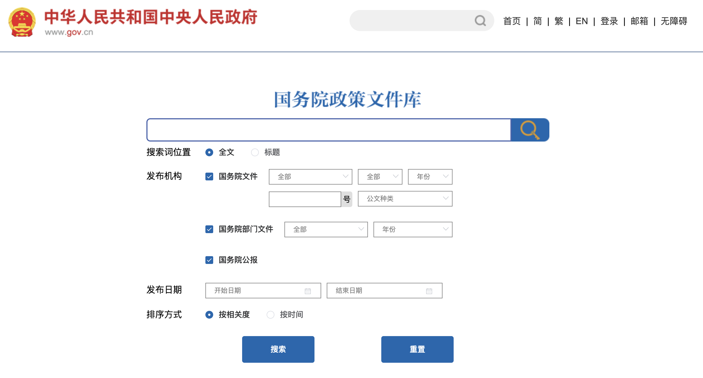

Research Design
Data Source:
Policy documents of the State Council and its ministries (2021–2025)
Paragraph-level text units
Document-level topic tags represent administrative categories, but they do not necessarily reflect the actual distribution of governance functions.
For Example:
The document is categorized as "Agriculture"
However, the document may contain:
Social Welfare
Environmental Protection
Macroeconomic Regulation

Slide 5
Data Processing Flow
Web crawler to extract documents
Data Cleaning (paragraph level)
LDA test for natural topic differentiation
Supervised learning (comparative model)
Label Samples
Building five major governance fields
The following chapters will explain in detail.

Slide 6
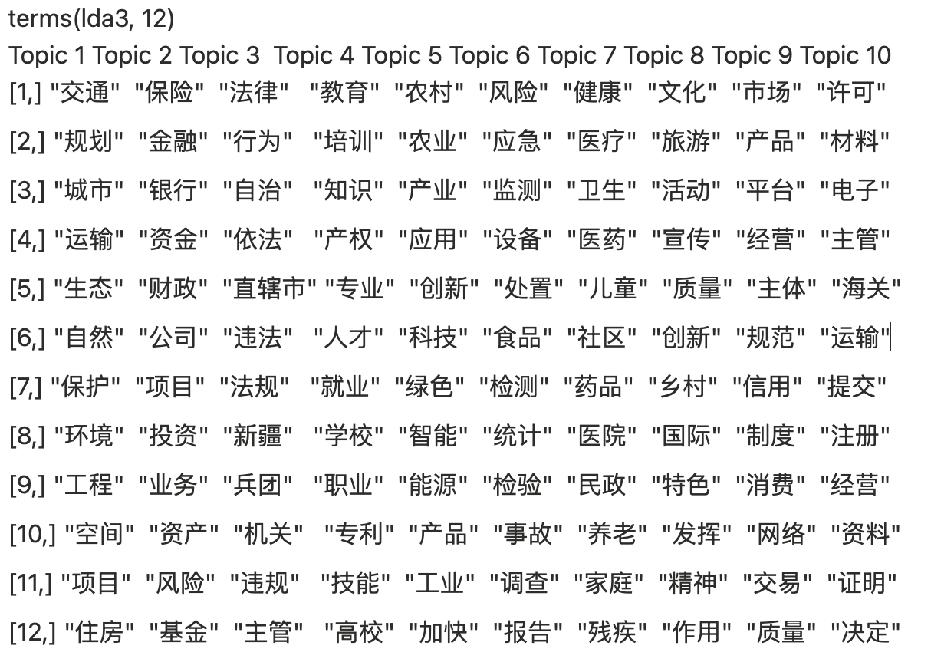
LDA Test
Current research hypothesizes that paragraphs can represent different policy concerns.
The role of LDA is to answer the question: Do paragraphs naturally form multiple clusters in the semantic space?
If the topics obtained by LDA are very disorganized, it indicates that the paragraph level is not suitable for semantic differentiation.
This proves that the text itself naturally differentiates into several governance areas.

Slide 7
Five major governance fields
Governance Objectives Structure (Based on the 14th Five-Year Plan):
1. Innovation and Modern Industrial System（创新与现代产业体系）
2. Macroeconomics and Resource Allocation（宏观经济与资源配置）
3. Green Development and Ecological Civilization（绿色发展与生态文明）
4. Social Welfare and Social Development（民生与社会发展）
5. Public Safety（公共安全）
The study focuses on the State Council's implementation documents for 2021–2025.
The 14th Five-Year Plan serves as the overarching framework for all policy formulation during this period.
Therefore, the research document was generated within this structural framework.
Rather than adopting its full chapter structure, five core governance functions are abstracted that correspond to development capacity, macro-regulation, sustainability constraints, social reproduction, and risk governance.

Slide 8
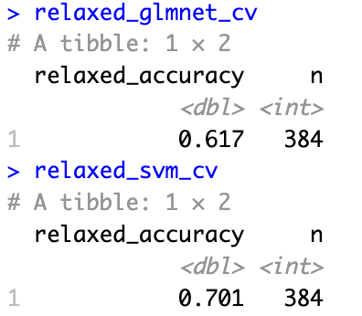
Supervised learning (comparative model)
A multi-class classification model was trained using manual annotation, and then the model was used to predict the governance objectives of 130,000 paragraphs.
Feature Engineering:
Model input includes two types of features:
A. Text Features: Semantic Generalization
→ Capturing paragraph semantic structure
B. Structural Features
- doc_type
- topic_lvl1
- topic_lvl2
- dominant_topic
→ Capturing institutional and policy classification information
Model Selection:
glmnet multinomial (with L1 regularization)
Linear SVM

Slide 9
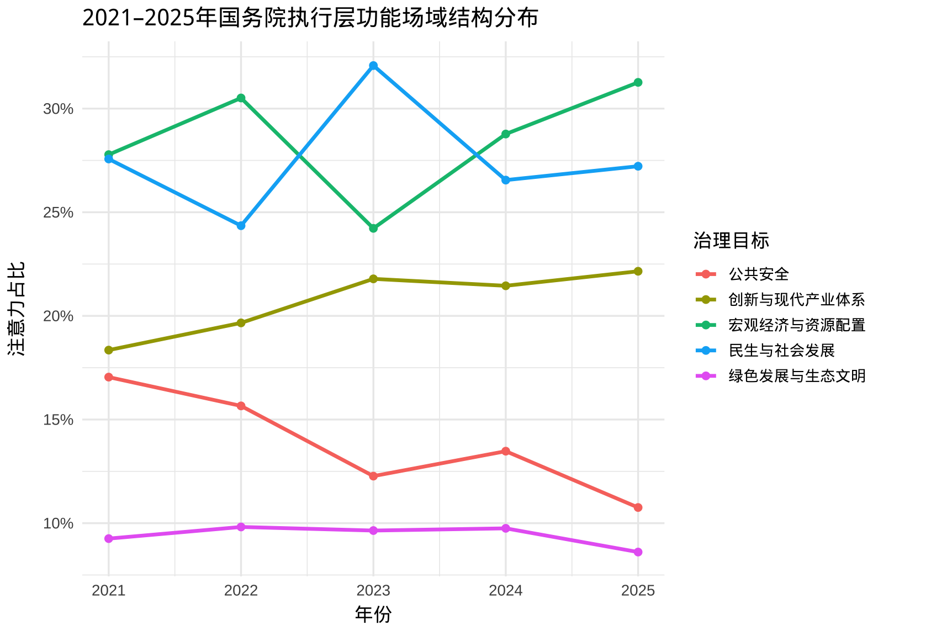
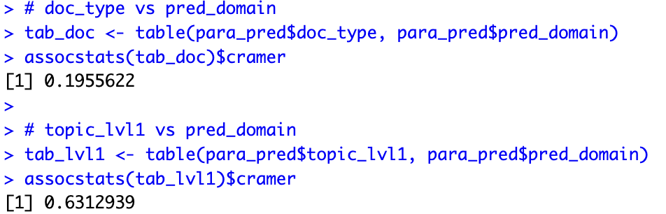
Key Finding - Functional Structure
From 2021 to 2025, the policy texts of the State Council's executive level exhibited a stable functional field structure;
this structure was primarily driven by "policy themes/governance tasks," rather than by document type.

Slide 10
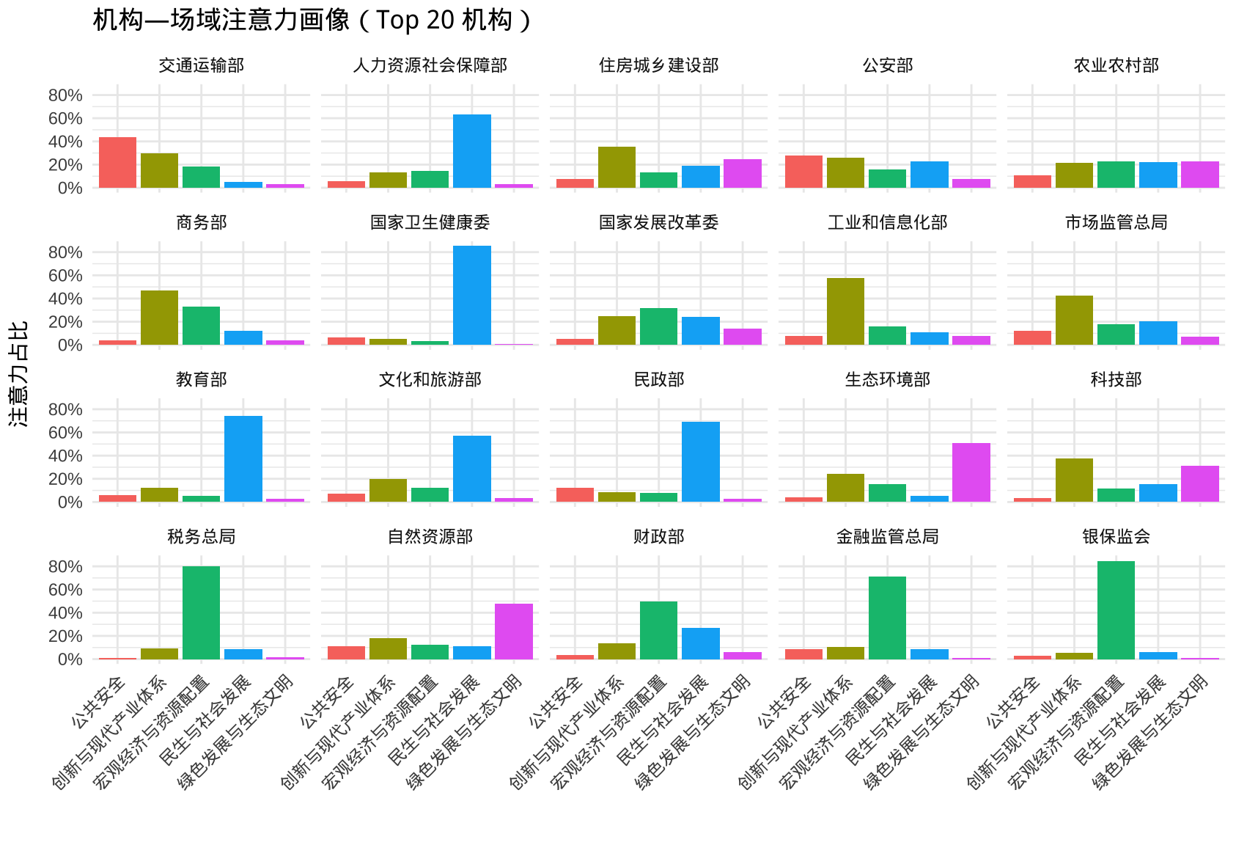
Structural differentiation at the organizational level
The distribution of governance objectives in executive-level texts can create identifiable "functional positions" at the organizational level.
The text itself is a trace of the organizational functional division of labor.
Each small diagram represents the field attention structure of a single institution.
Many institutions exhibit a single peak or a strong dominant peak → clear functional division.
A few institutions exhibit multiple peaks → may involve cross-field governance

Slide 11
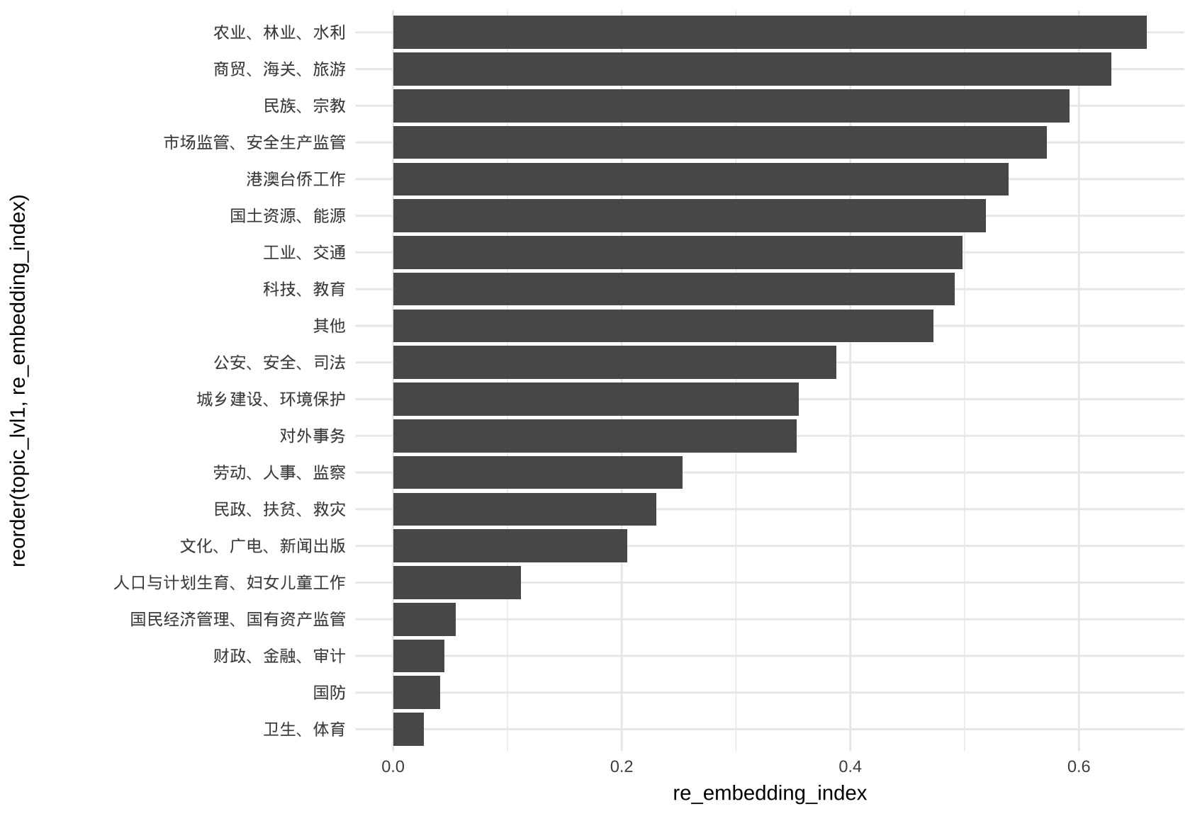
The existence of "re-embedding" domain
re_embedding_index = 1 - top_share
high top_share → The topic is almost monopolized by a single domain → low re-embedding
low top_share → The topic is distributed across multiple domains → high re-embedding
Land resources, industry, and transportation: these are not only development/industry, but also involve security, ecology, and macro-level allocation.
These are not "specialized areas" with a single policy objective, but rather "connector" in the governance system—connecting multiple objectives such as growth, people's livelihood, security, ecology, and governance order.

Slide 12
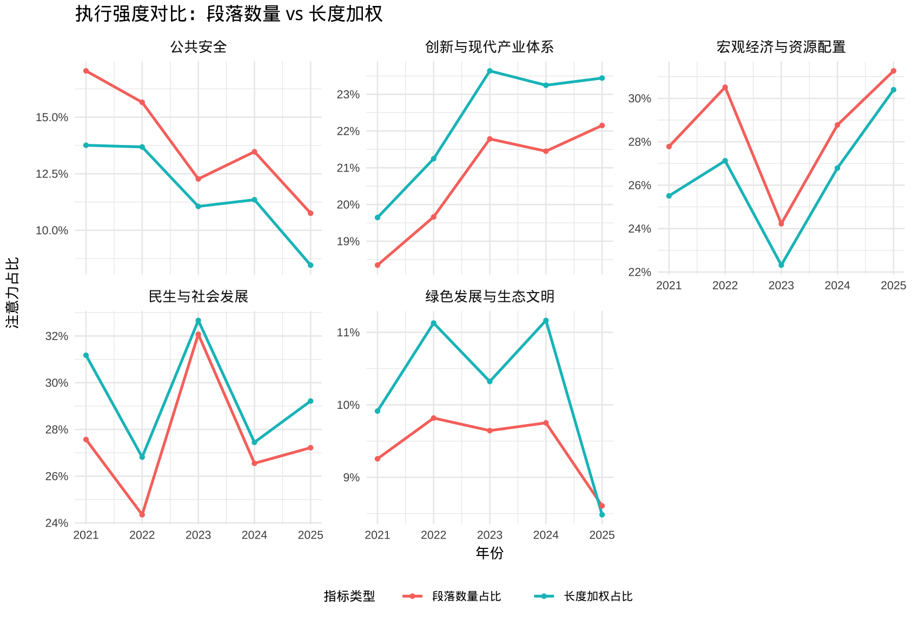
Text intensity difference
1. Social Welfare and Social Development:
The blue line has consistently been above the red line.
This means: Policies related to people's livelihoods have longer paragraphs and more comprehensive policy expression.
Explanation: Policies concerning people's livelihoods involve specific groups.
2. Innovation and the Modern Industrial System
Length proportion consistently higher than paragraph proportion
Note: Innovation-related policy texts also tend to be longer.
3.Green Development:
In most years, the blue line is higher than the red line.
Note: Green policies are described in some detail, but not as clearly as those related to social welfare and innovation.
4. Macroeconomic and Resource Allocation
In most years, the blue line is below the red line.
Note: There are many paragraphs on macroeconomic policies, but the average length is shorter.
Possible Explanation: Indicator Setting, Principle Requirements
5. Public Safety: The blue line has consistently been below the red line.
Note: Safety policies tend to be short, imperative, and contain explicit clauses.
Possible Logic: Imperative expressions and clear division of responsibilities eliminate the need for lengthy explanations.

Slide 13
Shortcoming
1. My functional space is derived from the 14th Five-Year Plan, which provides institutional legitimacy but may constrain alternative clustering structures emerging from the data itself.
Future work may compare institutionally derived categories with fully unsupervised topic models to test robustness.
2. My analysis focuses on policy discourse at the implementation level rather than observable administrative outputs, which may not fully capture actual resource allocation or enforcement behavior.
3. Although classification performance is relatively strong, misclassification may introduce measurement noise, especially across semantically adjacent domains.
4. My temporal scope is confined to the 14th Five-Year period; longitudinal extension to earlier planning cycles would help assess structural persistence.

Slide 14
Thank You!

